Slide 1
Part 21 Edition 3
Final Review before submission to ISO
Dr. Martin Hardwick
President STEP Tools, Inc.
Team Leader ISO STEP-Manufacturing
Professor of Computer Science, RPI

Slide 2
Part 21 Editions 1 & 2
Very successful - edition 1 in 1994, edition 2 in 2002
  Implemented by all the CAD, CAM and BIM vendors.
  Upward compatible across many, many enhancements.
  Very fast performance by translation systems.
Designed for easy implementation
  Minimal data format for maximal upward compatibility.
  No URI’s, OIDs of other fancy features.
  No concessions to easy data presentation.

Slide 3
Design goals of Part 21 Edition 3
Massive Product Models
  Divide large files into multiple smaller files
  Support data linking outside of a single CAD system
  With appropriate abstraction, modularity and security
Crowdsourcing
  Enable easier programming
  Make room for efficient data structures
  Add intelligence using JavaScript

Slide 4
Anchors and References
ISO-10303-21;
HEADER;
FILE_DESCRIPTION( ... )
FILE_NAME( ... );
FILE_SCHEMA ( ... );
ENDSEC;
ANCHOR;
<tool_tip_face> = #100;
<UUID> = #100;
<tool_tip_unused> = $;
ENDSEC;
REFERENCE;
#1234 = <http://www.tool.com/mill#bottom_face>;
#1235 = <http://www.tool.com/mill#bottom_face_rep>;
ENDSEC;
DATA;
#100= CHAIN_BASED_GEOMETRIC_ITEM_SPECIFIC_USAGE
( . . ., #1234, (#1235,#22,#23) . . .);
ENDSEC;
END-ISO-10303-21;
In-bound
Out-bound
Nearly Unchanged

Slide 5
Signatures
Signature based on hash of contents and crypto key
Assures source of data and absence of tampering
Placed at end of file - Multiple signatures allowed
DATA;
…..
END_SECTION;
END_ISO10303-21;
SIGNATURE;
vnjfn457vfu0+v8vhn9vnfnvbgbjdnvnjfn457vfu0+v8vhn9vnfnvbgbjdnvnjfn457vfu0+v8vhn9vnfnvbgbjdn
buic889ruivuj890fv89vbhfuntf565sdfujhiofbhf789d0bhfgbhfguvbh78vfvvbhbvydu8vbffvbdsuivdfvbfuy6
….
END_SECTION;
1st signature
SIGNATURE;
A1yBCCQAc27kxxdf3iMQTxg+4jKqYRN6TPnHmV3ZQfyFwmj5Bf76SkvHx0DnJN3Ofpzh2x7n4Ui+nxuu7JeuP3YYNWj4Qo8Etn/3/26nRKdM3tTWapUo3F7Ul5GPOEi+uZ/jYNyagLwvulNFM5sqUdI01Nx6
….
END_SECTION;
2nd signature

Slide 6
Multi-file ZIPs
ZIP can contain many files
ISO-10303.p21 is used as root
External references are to the root and forwarded to subsidiaries
Root signature also signs the subsidiaries (like JAR files)
Multi-file ZIP
Root file
Assembly.stp
External references are to root file only
ISO-10303.p21
References
Signature
Geometry.stp
PMI.stp
Wing.stpz

Slide 7
Conformance Classes
Character set updated to UTF-8 ISO 10646
Anchor section enables UUID references into the data
Signature section prevents tampering
Reference section enables references out of the data
ZIP/directories for modularity and abstraction
Values and EXPRESS constants in data section
JavaScript for intelligent applications
CC1
CC2
CC3
CC1 does not disturb existing implementations
CC2 requires a pre-processor to resolve the references
CC3 is a new class of implementation for intelligent manufacturing

Slide 8
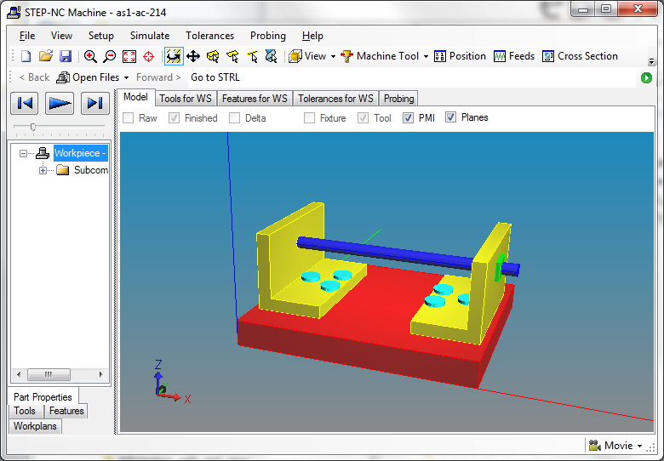
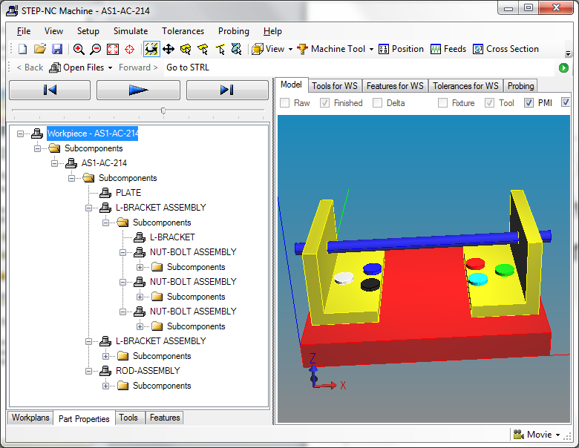
Wg11 Testing
PMI same for all bolts
PMI individualized
One
P21 file
Many
linked
P21 files
Like LOTAR
Test Case 1
Like LOTAR
Test Case 4

Slide 9
LOTAR Suggestions
Test case 1 – Single file AS1 with assembly tolerances
  Use CC1 to add a digital signature
  ftp://ftp.steptools.com/private/P21e3_DIS_testing/Digital_signatures/
Test case 2 – Test Case 1 with external geometry files
  Use CC1 to UUID the PMI geometry instances
  ftp://ftp.steptools.com/private/P21e3_DIS_testing/UUID/
Test case 3 – Test Case 2 with side bar PMI file
  Use CC2 to enable references from PMI to geometry
  ftp://ftp.steptools.com/private/P21e3_DIS_testing/PMI/
Test case 4 – Test Case 3 with nested assembly files
  Use CC2 to enable multi-file ZIP
  ftp://ftp.steptools.com/private/P21e3_DIS_testing/ZIP_Assembly/

Slide 10
Getting Started
Open source* for digital signatures is at:
  https://github.com/steptools/STEPAuthorize
Open source for making UUID anchors is at:
  https://github.com/steptools/PDef-UUID-Anchor-Generator
Open source for splitting and merging STEP files is at:
  https://github.com/steptools/P21e3-Merge-Split-Tools
*The applications use the personal edition of ST-Developer, which is a free download at:
http://www.steptools.com/products/stdev/personal.html

Slide 11
Backup

Slide 12
More on the WG11 Test Case
Splitting procedure
  Split into assembly files and geometry files
  Assign UUID to each instance
  Define PMI for each instance.
  Define anchors for next higher placements
  Define references to assembly components

Slide 13
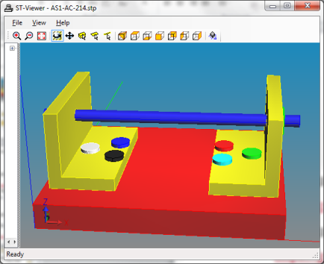

1. Split into files
nut.stp
white.stp
blue.stp
black.stp
red.stp
cyan.stp
green.stp
L-bracket.stp
bracket.stp
R-bracket.stp
yellow1.stp
AS1.stp
yellow2.stp
Red, green, yellow are PMI files
Nut and bracket are geometry files
L-bracket and R-bracket are assembly files

Slide 14
2. UUID each PMI reference
ISO-10303-21;
HEADER;
FILE_DESCRIPTION( ... )
FILE_NAME( 'nut' );
FILE_SCHEMA ( ... );
ENDSEC;
ANCHOR;
<86a45428-819b-4a99-8e9d-cc503e2531f3-manifold>=#10; // white
<f06df0b0-7696-41b2-8f9d-1590826cd462-manifold>=#10; // blue
<46da6244-53c5-4cac-9c90-743f5638de51-manifold>=#10; // black
<5aad893f-8768-4cb6-9175-f8650e8a77d5-manifold>=#10; // red
<efb70fe7-2989-4111-ab26-024c1803fa96-manifold>=#10; // cyan
<cae3a809-d0cb-4e53-a66c-7c1b74c76f20-manifold>=#10; // green
ENDSEC;
DATA;
#10= MANIFOLD_SOLID_BREP('100',#5432);
ENDSEC;
END-ISO-10303-21;
nut.stp

Slide 15
3. Define PMI for each instance
ISO-10303-21;
HEADER;
FILE_DESCRIPTION(
FILE_NAME('green.stp');
FILE_SCHEMA ( ... );
ENDSEC;
REFERENCE;
#243=<nut.stp#cae3a809-d0cb-4e53-a66c-7c1b74c76f20-manifold>; // green UUID
ENDSEC;
DATA;
/************************************************
* Application object: SINGLE_STYLED_ITEM (#10)
* ITS_PREDEFINED_COLOR: #10, #11, #12, #13, #14, #15, #16, #17, ['green']
*/
#10=STYLED_ITEM('NONE',(#11),#243);
#11=PRESENTATION_STYLE_ASSIGNMENT((#12));
#12=SURFACE_STYLE_USAGE(.BOTH.,#13);
#13=SURFACE_SIDE_STYLE('NONE',(#14));
#14=SURFACE_STYLE_FILL_AREA(#15);
#15=FILL_AREA_STYLE('NONE',(#16));
#16=FILL_AREA_STYLE_COLOUR('NONE',#17);
#17=DRAUGHTING_PRE_DEFINED_COLOUR('green');
#20=MECHANICAL_DESIGN_GEOMETRIC_PRESENTATION_REPRESENTATION('',(#10),$);
ENDSEC;
END-ISO-10303-21;
green.stp

Slide 16
4. Define anchors for next higher assembly placement
ISO-10303-21;
HEADER;
FILE_DESCRIPTION(
FILE_NAME('green.stp');
FILE_SCHEMA ( ... );
ENDSEC;
ANCHOR; // for reference in next higher assembly placement
<cae3a809-d0cb-4e53-a66c-7c1b74c76f20-product_definition> = #100;
<cae3a809-d0cb-4e53-a66c-7c1b74c76f20-axis_placement> = #200;
<cae3a809-d0cb-4e53-a66c-7c1b74c76f20-shape_representation> = #300;
REFERENCE;
#243=<nut.stp#cae3a809-d0cb-4e53-a66c-7c1b74c76f20-manifold>; // green UUID
#100=<nut.stp#cae3a809-d0cb-4e53-a66c-7c1b74c76f20-product_definition>;
#200=<nut.stp#cae3a809-d0cb-4e53-a66c-7c1b74c76f20-axis_placement>;
#300=<nut.stp#cae3a809-d0cb-4e53-a66c-7c1b74c76f20-shape_representation>;
ENDSEC;
DATA;
/************************************************
* Application object: SINGLE_STYLED_ITEM (#10)
* ITS_PREDEFINED_COLOR: #10, #11, #12, #13, #14, #15, #16, #17, ['green']
*/
#10=STYLED_ITEM('NONE',(#11),#243);
#11=PRESENTATION_STYLE_ASSIGNMENT((#12));
#12=SURFACE_STYLE_USAGE(.BOTH.,#13);
#13=SURFACE_SIDE_STYLE('NONE',(#14));
#14=SURFACE_STYLE_FILL_AREA(#15);
#15=FILL_AREA_STYLE('NONE',(#16));
#16=FILL_AREA_STYLE_COLOUR('NONE',#17);
#17=DRAUGHTING_PRE_DEFINED_COLOUR('green');
#20=MECHANICAL_DESIGN_GEOMETRIC_PRESENTATION_REPRESENTATION('',(#10),$);
ENDSEC;
END-ISO-10303-21;
green.stp

Slide 17
5. Define references to components
ISO-10303-21;
HEADER;
FILE_DESCRIPTION( … );
FILE_NAME( R-Bracket );
FILE_SCHEMA ( … );
ENDSEC;
ANCHOR; // UUIDS for R-bracket will be referenced in the AS1 assembly
<7bf67468-59c4-42e0-88d8-24947b87898a-product_definition>=#10;
<7bf67468-59c4-42e0-88d8-24947b87898a-shape_representation>=#13;
<7bf67468-59c4-42e0-88d8-24947b87898a-axis_placement>=#18;
// shape will be colored by yellow2.stp
<7bf67468-59c4-42e0-88d8-24947b87898a-manifold>=#70;
ENDSEC;
REFERENCE; // to bolts
#59=<green.stp#cae3a809-d0cb-4e53-a66c-7c1b74c76f20-product_definition>;
#60=<green.stp#cae3a809-d0cb-4e53-a66c-7c1b74c76f20-axis_placement>;
#61=<green.stp#cae3a809-d0cb-4e53-a66c-7c1b74c76f20-shape_representation>;
// to bracket for underlying geometry
#70=<bracket.stp#7bf67468-59c4-42e0-88d8-24947b87898a-manifold>;
ENDSEC;
DATA;
// Entities to define the R-Bracket assembly
R-bracket.stp

Slide 18
Summary
Geometry is not duplicated
Each component has its own PMI file
Organization is optional – data can be merged into one file
Hierarchical organization is probably going to be preferred
Multi-file ZIP will make the data easy to share and manage
Requires e3 except for the geometry files which can be left as e2 by putting the anchors into the PMI files

